Slide 1
Development and Assessment of Regional Atmospheric Nudging in ACCESS
Christian Stassen
Modelling Scientist
Bureau of Meteorology

Slide 2
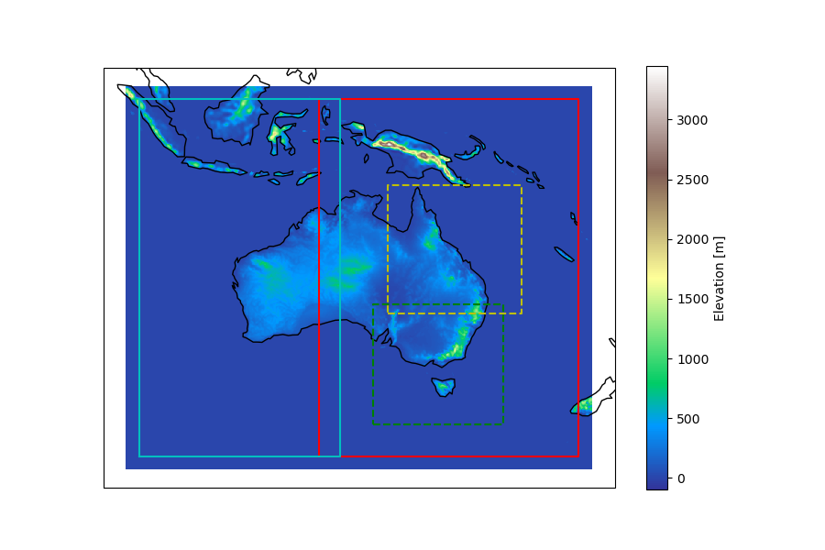
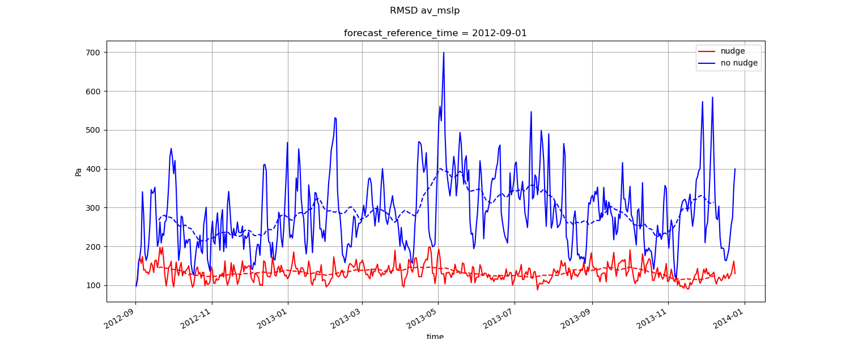
Objective
Extend BARPA to full Australasia CORDEX domain
Stay close to driving model
Nudging should not dominate tendency equations
Nudging should not limit high-res extreme events
BARPA-WA
BARPA-EA

Slide 3
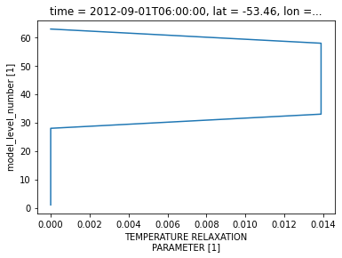

Method
Newtonian nudging
$ΔX=F\left(X\right)+G⋅Δt⋅(X_{driving}−X)$
Nudging the regional model towards driving model at every timestep with strength G
Do not nudge too strong or too weak
Do not nudge in PBL
32000m
18000m
11000m
6400m
2900m
800m

Slide 4

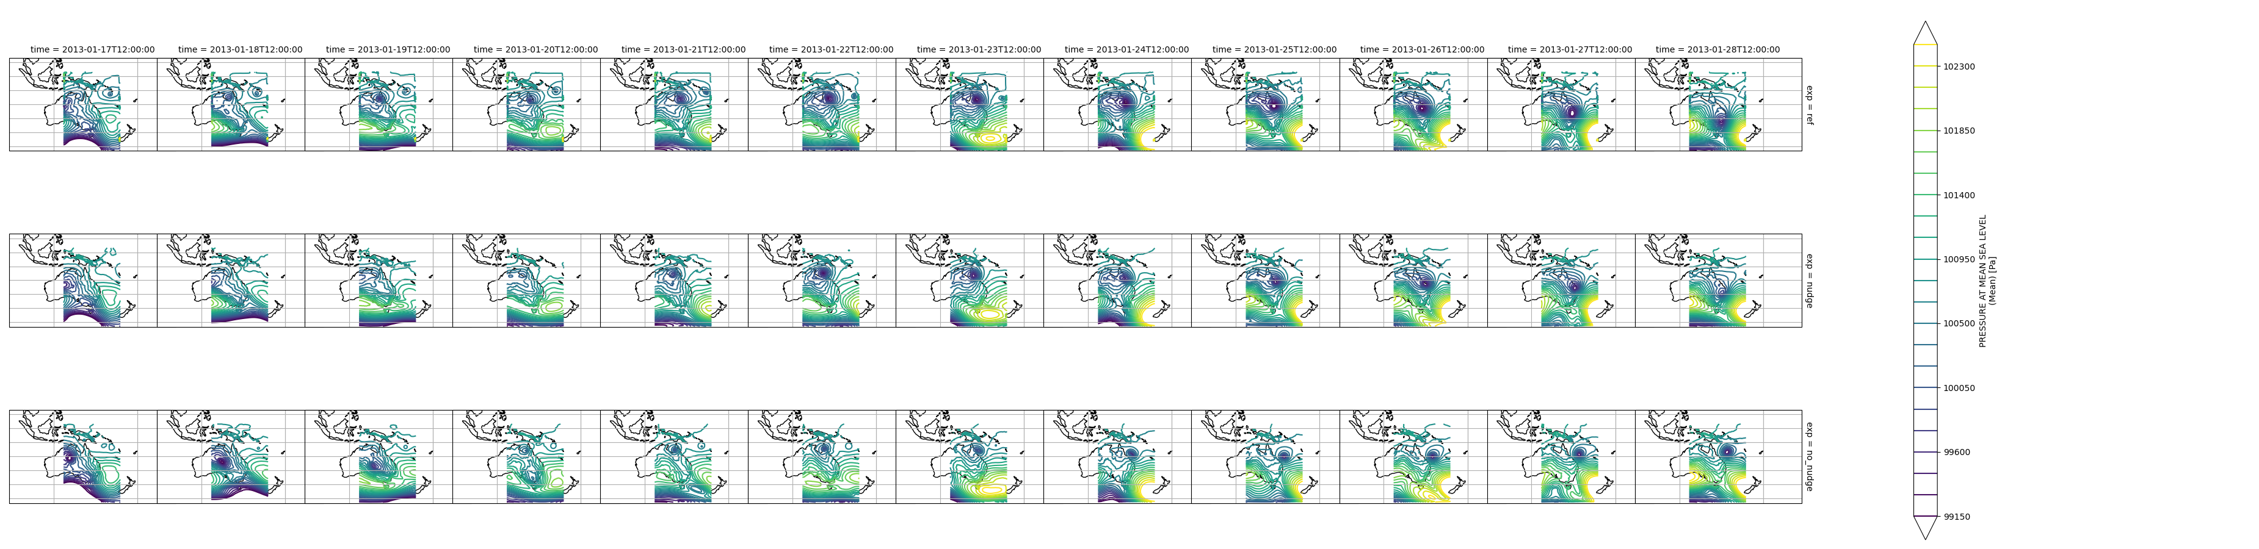
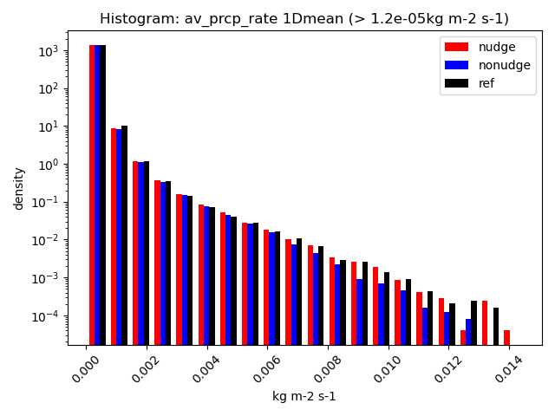
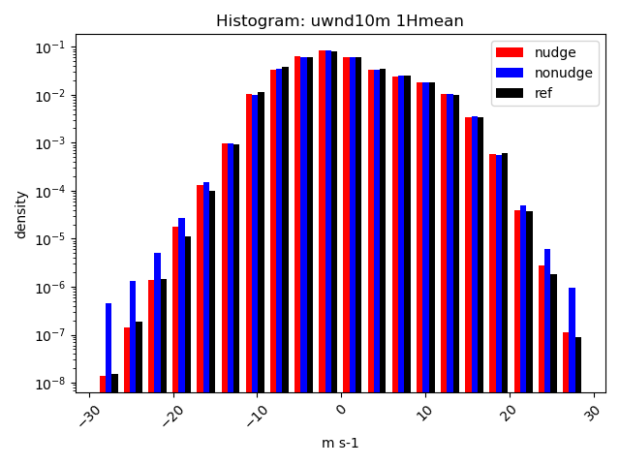
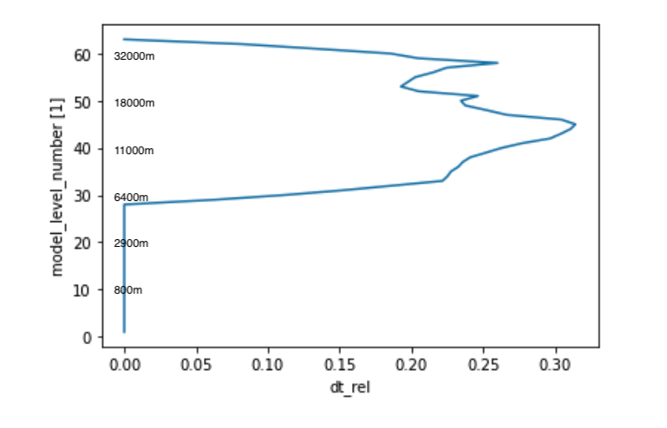
Results
Completed 1-year trial
Extend BARPA to full Australasia CORDEX domain
Stay close to driving model
Nudging should not dominate tendency equations
Nudging should not limit high-res extreme events

Slide 5
Conclusion
Initial nudging results are very promising
Nudging keeps large scale closer to driving model
MSLP and TC
Nudging maintains small scale features
Like extreme precipitation and winds
Nudging does not dominate tendency equations
Next steps
Analyse second sensitivity experiment with nudging higher up in atmosphere
Performs improvements
Nudging requires about double resources
Potentially extend nudging simulation for longer periods

Slide 6
Thank you
christian.stassen@bom.gov.au
Collaborators:
Chun-Hsu Su, Peter Steinle, Andrew Dowdy, et al.

